Slide 1

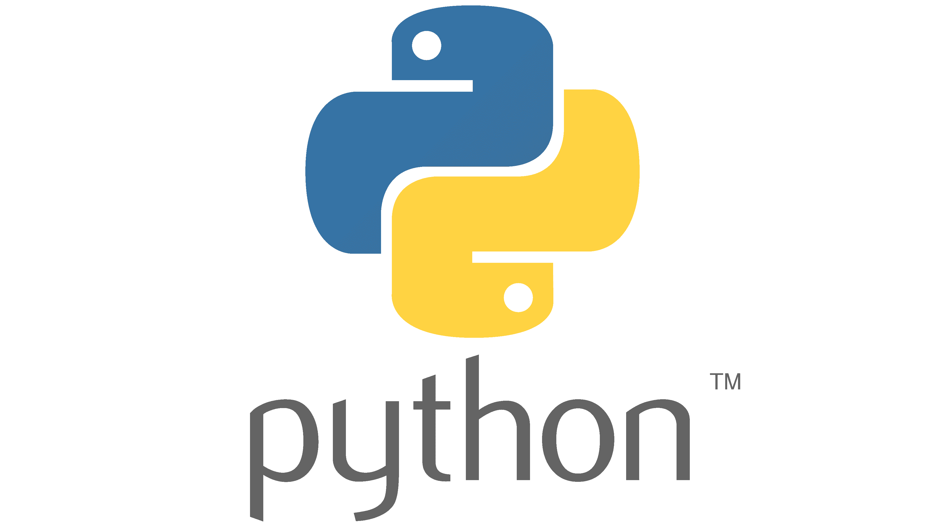
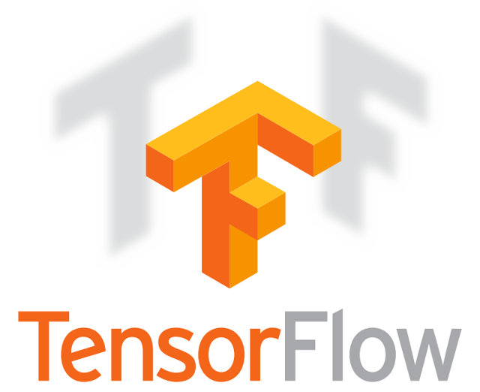

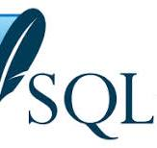
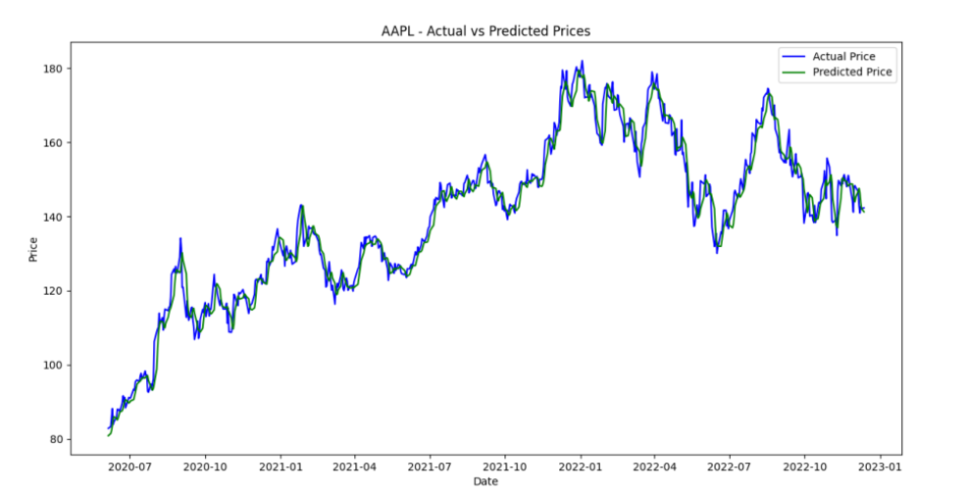
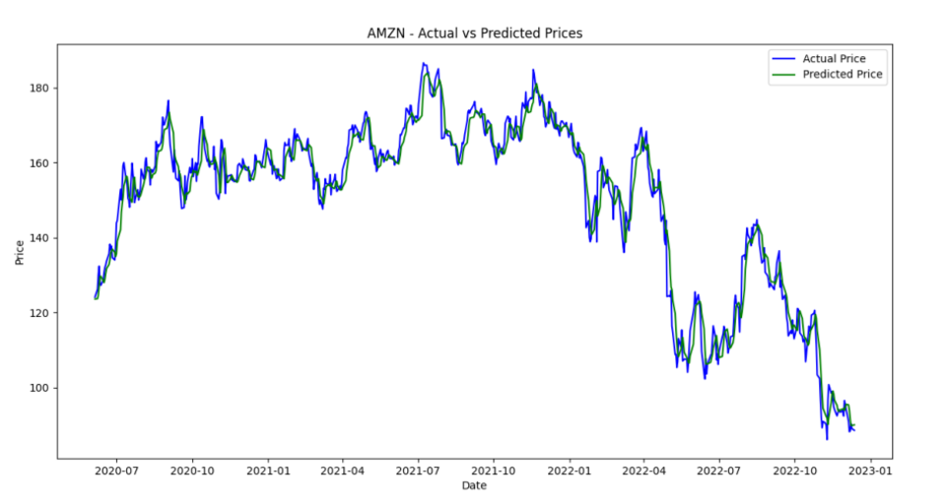

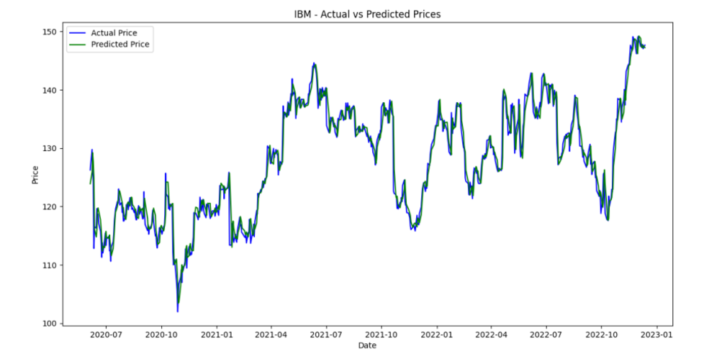
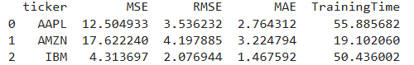
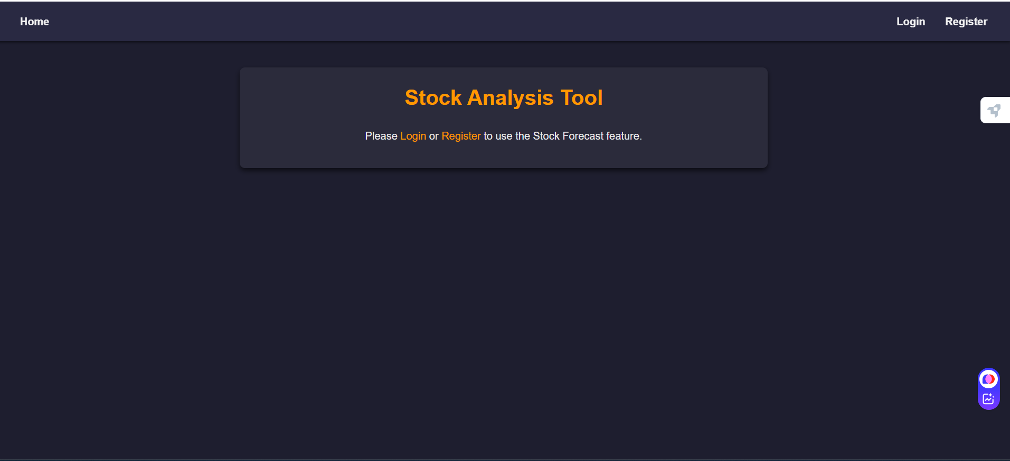
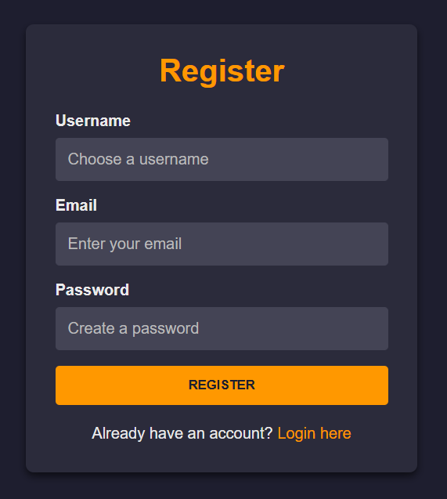
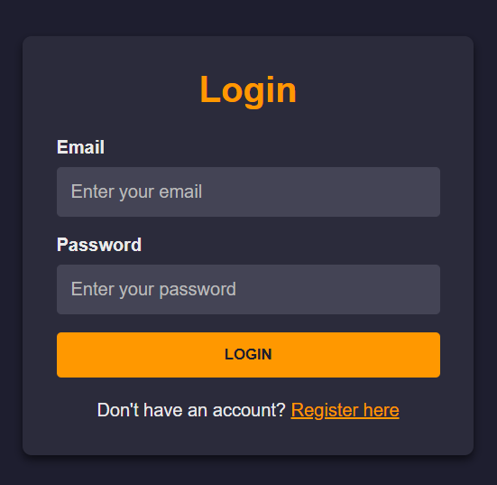
Stock Market Analysis using LSTM
Jahnavi Palyam, VegappaReddy Gari Sudharshan Reddy
Department of computer engineering in Machine Learning
Introduction
Predicting stock prices has always been a challenging yet essential task for investors and traders. With so much historical data available, it can be overwhelming to analyze trends and make accurate predictions using traditional methods. This makes it difficult for investors to make well-informed decisions in the fast-paced world of financial markets . Our project simplifies this process by using advanced machine learning, specifically LSTM (Long Short-Term Memory) models, to predict stock prices based on historical data. The application is designed to be user-friendly, offering an intuitive platform where users can easily predict future stock prices, explore trends, and visualize the results through interactive charts . By combining secure user accounts, reliable predictions, and clear visualizations, this tool empowers users to gain valuable insights into stock market trends. Whether you're a beginner or a seasoned trader, this application makes advanced financial analytics accessible and actionable.
Software Overview
Materials and Methods
User Interface:
Login and Registration: Simple forms for secure user access.
Prediction Dashboard: Users input stock tickers and prediction days to receive interactive charts showing historical and predicted prices.
Results:
Interactive Charts: Display historical prices alongside predicted prices for the next 10 days. Hover over points for exact values.
List of Major Features
User Authentication and Security : Users can register, log in, and securely access the platform. Passwords are safely encrypted, ensuring your data remains protected.
Stock Price Predictions : Predict future stock prices for your chosen company and desired number of days using advanced machine learning models.
Interactive Visualizations : Get clear, interactive charts showing historical stock trends alongside predicted prices, helping you spot patterns and make decisions.
Historical Data Analysis : Dive into historical stock data to see past trends and how prices have fluctuated over time.
Customizable Forecasting : Enter any stock ticker and set the number of days you want predictions for, tailoring the forecasts to your needs.
Seamless User Experience : An intuitive interface makes it easy for anyone, from beginners to seasoned investors, to navigate and use the system effectively.
Secure Data Management: Backed by a reliable database, all user data and interactions are securely managed and stored.
Future Development
Enhanced Prediction Models:
Addition: Integrate more advanced machine learning models such as GRU (Gated Recurrent Units) or Transformer models.
Benefit: Improve prediction accuracy and handle complex patterns in stock data more effectively.
2. Real-Time Data Integration:
Addition: Connect to APIs like Alpha Vantage or Yahoo Finance to fetch real-time stock market data.
Benefit: Enable live predictions and dynamic updates for traders and investors.
Acknowledgements
I would like to express our heartfelt gratitude to the following individuals and organizations for their invaluable support and contributions to this project
Team member: Sudharshan Reddy

